Slide 1
Lets React
A 2 hour workshop to get you started on your react journey

Slide 2
What is JavaScript
JavaScript is a scripting language that is used to create and manage dynamic web pages, basically anything that moves on your screen without requiring you to refresh your browser. This is based on ECMAScript. So the ECMAScript defines the syntax, data types, statements, operators, etc. (with ES6 currently being used).HTML and CSS is static, meaning a user cannot really interact with the page, here is where Javascript comes in.

Slide 3
Let, Var, Const
var: This is the most common way to declare a variable in JavaScript. It’s function-scoped, meaning the variable exists only within the function it was declared in. If declared outside any function, it’s globally scoped.
let: This is a block-scoped local variable, meaning the variable exists only within the block it was declared in
const: This is also block-scoped, but its value cannot be changed after it’s set, making it a constant. It’s a good practice to use const by default, and only use let when you plan to reassign the variable.

Slide 4
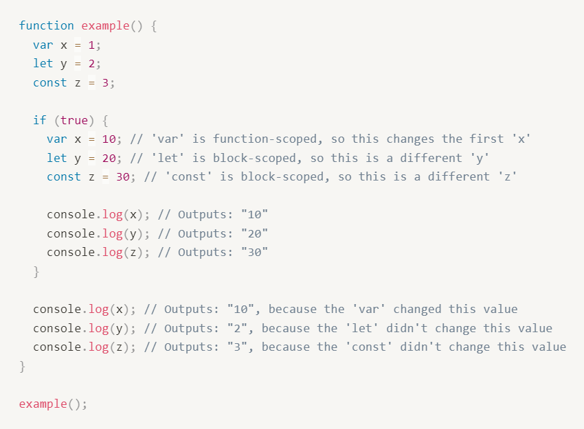
Let, Var, Const

Slide 5
Array Methods
forEach : The forEach() method executes a provided function once for every element of the array.
map: Creates a new array populated with the results of calling a provided function on every element in the calling array.
filter: creates a shallow copy of a portion of a given array, filtered down to just the elements from the given array that pass the test implemented by the provided function.

Slide 6
Newer JS
Spread operator: (…arr) The spread (...) syntax allows an iterable such as an array or string, to be expanded in new places.
Promises : The Promise object represents the eventual completion (or failure) of an asynchronous operation and its resulting value.
Await keyword: The await operator is used to wait for a Promise and get its fulfillment value. It can only be used inside an async function or at the top level of a module.

Slide 7
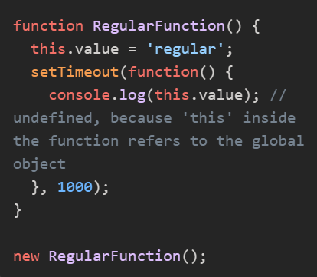
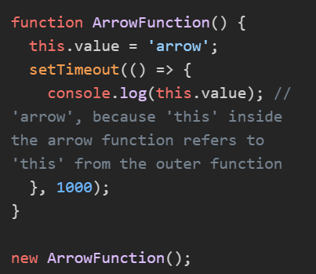
Arrow Functions
Arrow functions and regular functions in JavaScript are different in several ways, but the most significant difference is how they handle the this keyword.
In a regular function, this is determined by how the function is called. It can be different each time the function is called, and it’s not set until the function is invoked:

Slide 8
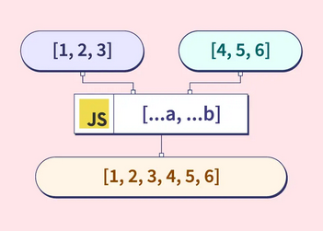
Spread Operators
The spread operator (...) in JavaScript is used to spread out elements of an iterable (like an array or object) into individual elements. Here are some examples:

Slide 9
What is REACT
React is a JavaScript library that's used for building reactive websites. It was made by Facebook back in 2011.
Facebook’s newsfeed used it first and now many websites like Airbnb, Instagram and Reddit use React to create their front-end.
(Appln diagram in eraser)

Slide 10
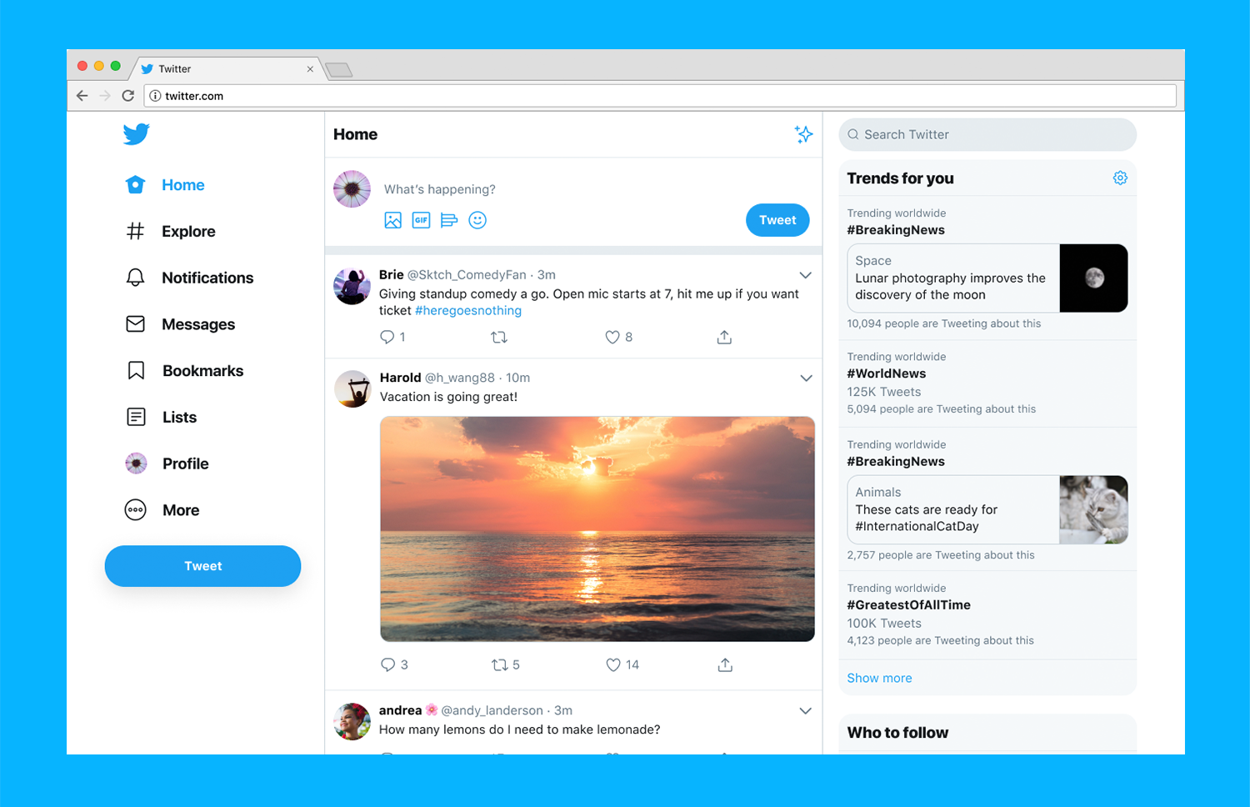
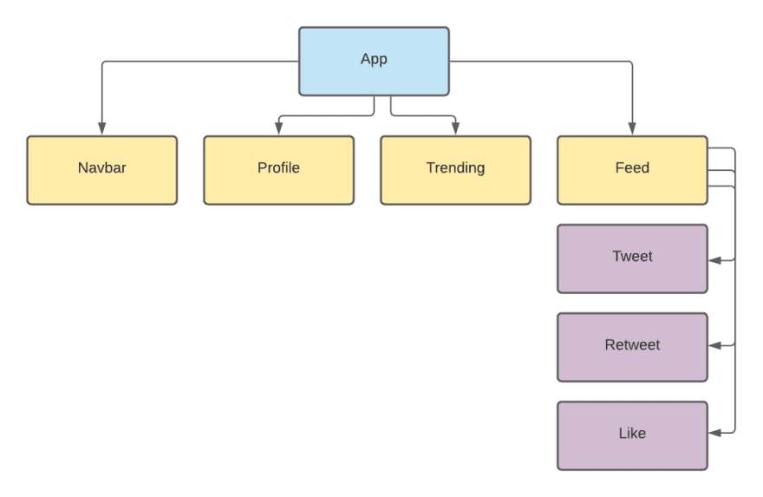
React is all about components as independent chunks of user interface.

Slide 11
What is REACT Component
A Component is considered as the core building blocks of a React application.
We can make a bunch of independent isolated and reusable user interfaces that we can assemble like Lego blocks and build complex apps.
Each application will have a root component
Behind the scenes React is using Virtual DOM(Data object Model-works like tree with nodes and objects) where only the component that needs to be updated is affected. Does not re-render the old app. Therefore increases the speed.

Slide 12

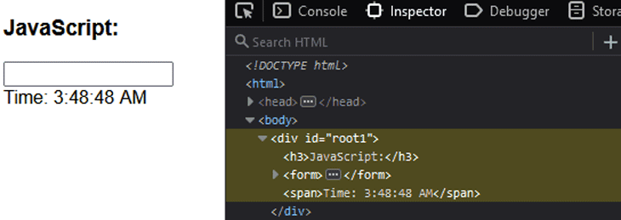
DOM in JS

Slide 13
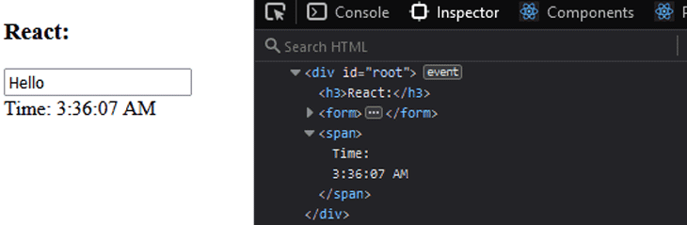
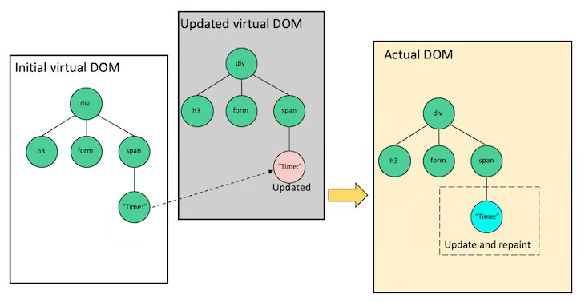
React Virtual DOM in Action

Slide 14
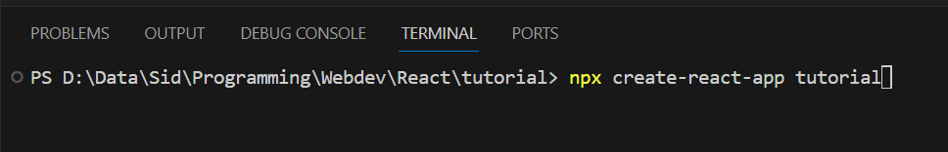
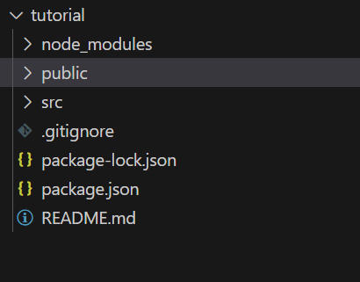
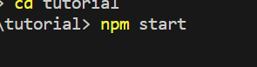
To start your creating your React Application
To run the application

Slide 15
Basic React Application Structure
public/index.html
When the application starts this is the first page that is loaded. This will be the only html file in the entire application since React is generally Written using JSX which I will cover later. Also, this file has a line of code <div id=”root”></div>. This line is very significant since all the application components are loaded into this div.

Slide 16
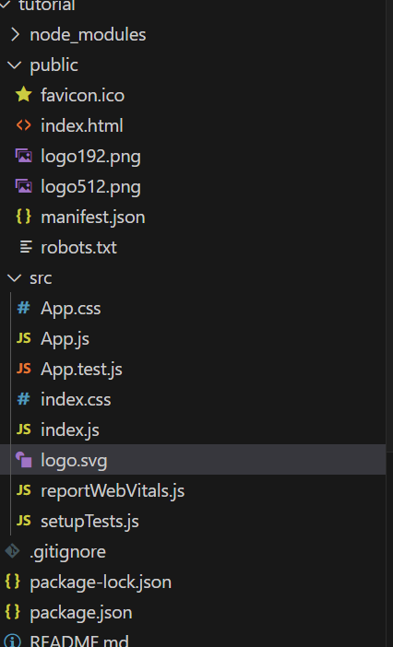
src/index.js:
This is the javascript file corresponding to index.html. This file has the following line of code which is very significant. ReactDOM.render(<App />, document.getElementById(‘root’));
src/App.js
This is the file for App Component. App Component is the main component in React which acts as a container for all other components.
package.json
Keeps track of all your dependencies (external libraries installed)

Slide 17
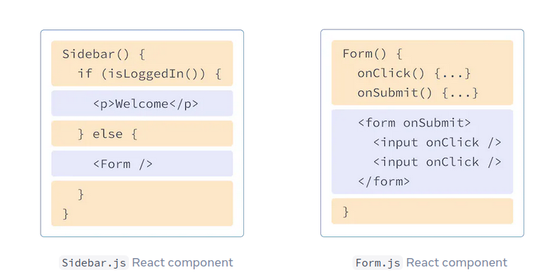
JSX (JavaScript XML)
Language created along side with React.
It allows us to write HTML inside JavaScript and place them in the DOM,
We are keeping Markup (the thing to be displayed) and the Logic (when to display or what to display) together!

Slide 18
Rules for JSX
Returns single element(keep everything in one parent element)
Use HTML semantics (div /section/article)(don’t just use div)
Use camelCase for html attributes
Eg <div onClick()>
Close every single element(even those with no end tag)
Eg.<img src= /><input />
Keep everything in return inside parenthesis.
To use JavaScript in the JSX use curly brackets. {}
We can declare variables inside and outside the function.

Slide 19
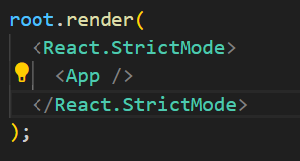
To create a component
Two Types of Components
Functional Components
Class Components
Functional Components are simpler and less verbose than class components and can be easier to reason about and test. They are also generally faster to render.
Function(component) name should start with capital to show its not a regular function.
--------------------------------------------------------------------------------------------------------------
How is the React app displayed?
In order to render any element into the Browser DOM, we need to have a container or root DOM element.
And then just inject it into the HTML (remember index.html has root)

Slide 20
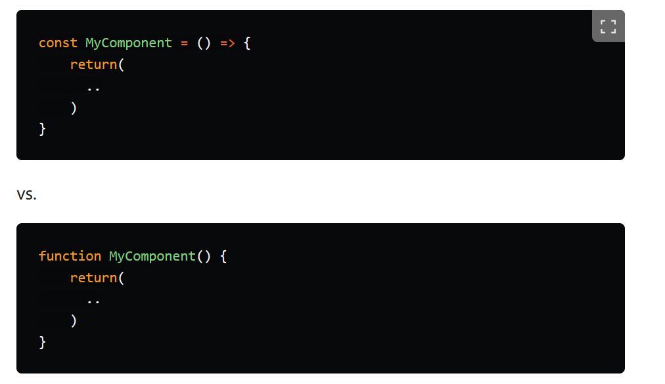
Functional Component
It should always return something. If not returned error.
We can have only one default export per file.
1st one better (Hoisting)
Some useful extensions:
Extension es7+ for boilerplates
rafce-to make arrow function (React functional Component)
rfce-to make normal function

Slide 21
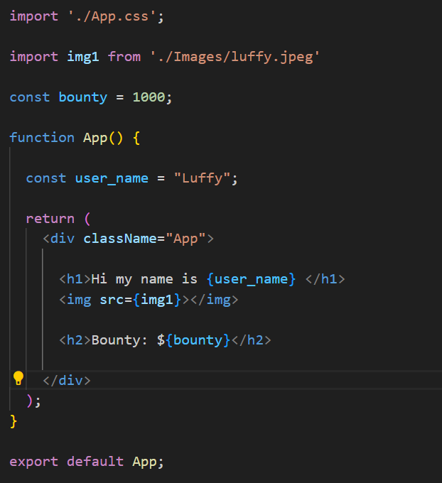


Slide 22
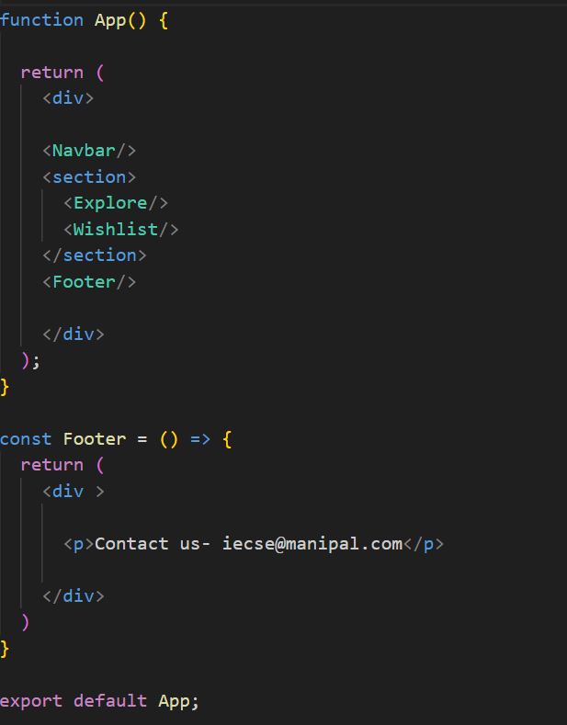
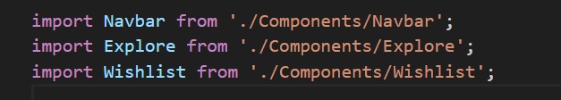
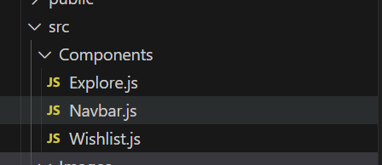
Nested Components
We can split up our application into many simple components.
The components that are nested inside parent components are called child components.
Render the function that is the base.
Different Components could be in the same file or imported from different files.(structure in eraser)

Slide 23
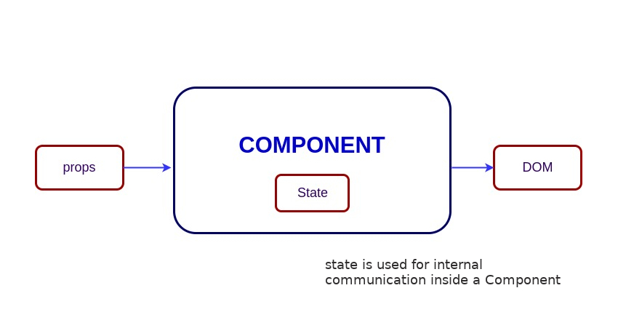
Props & States
The props in React are the inputs to a component of React. They can be single-valued or objects having a set of values.
The state is a built-in React object that is used to contain data or information about the component.
We will learn about State further when we come across the hook useState.

Slide 24
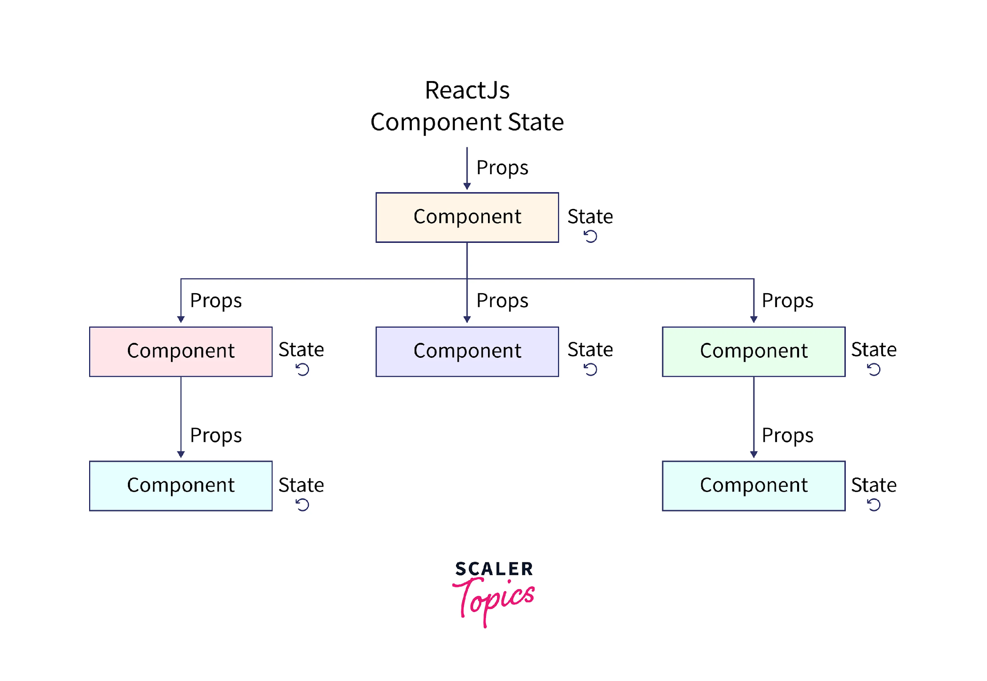

Slide 25
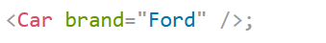
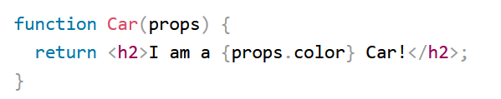
Props
The explore card needs values to be displayed. We can use the parent component to pass its values
To pass a prop to a child.
Props are read-only
Whereas the state can be changed

Slide 26
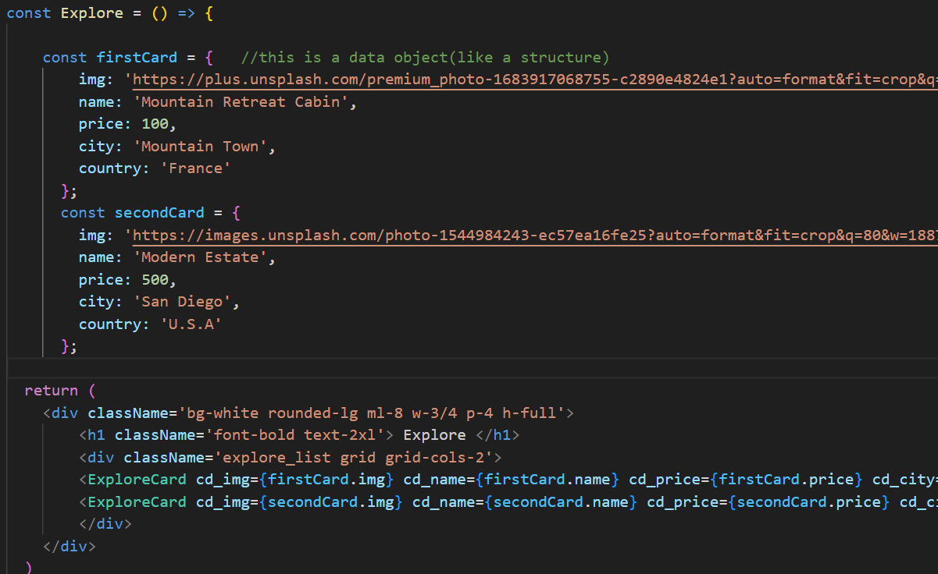
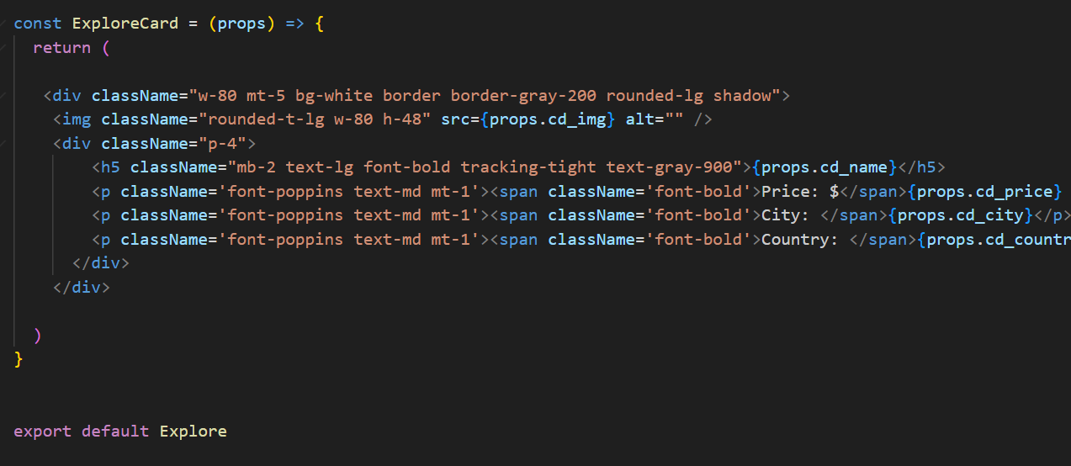

Slide 27
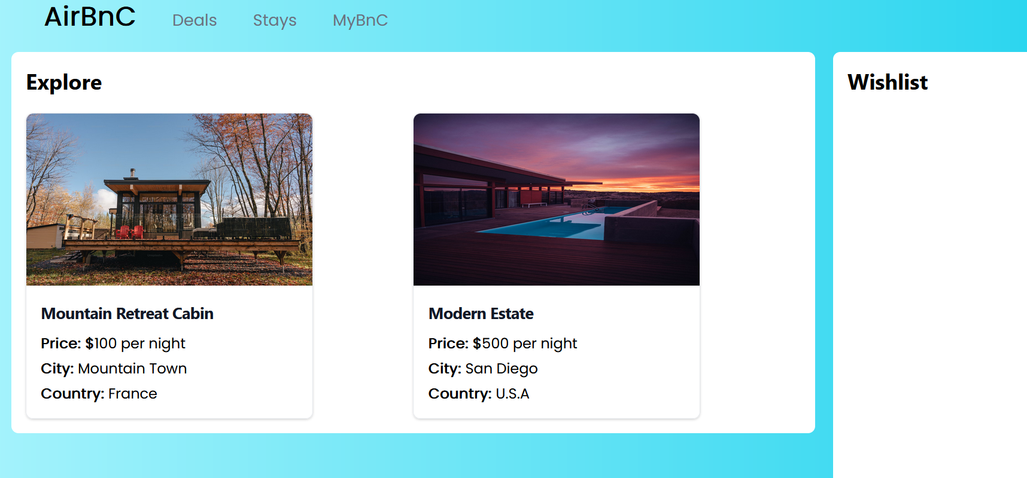

Slide 28
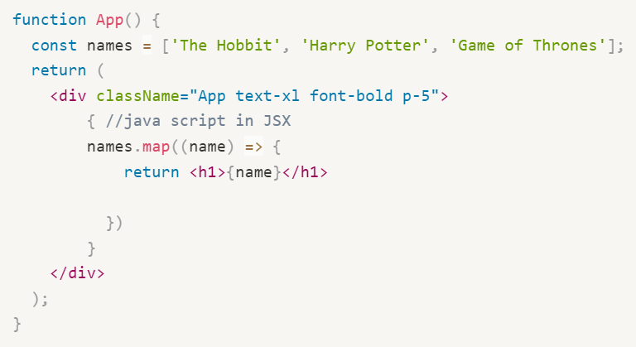
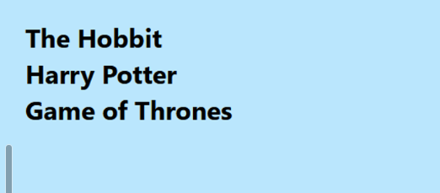
Lists
Lists are used to display data in an ordered format and mainly used to display menus on websites.
The map() function is used for traversing the lists.

Slide 29
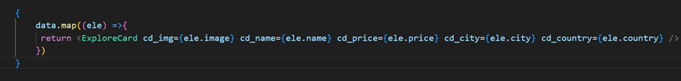
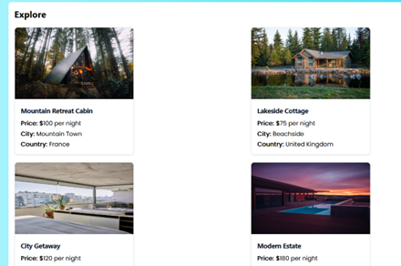
List with Components

Slide 30
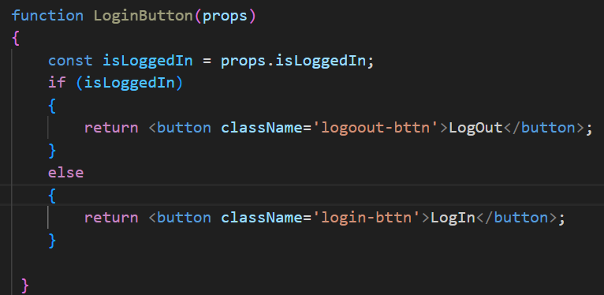
Conditional Rendering
Displaying different component based on a certain condition.
Using if and else

Slide 31
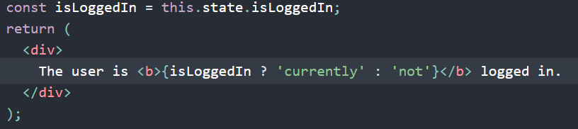
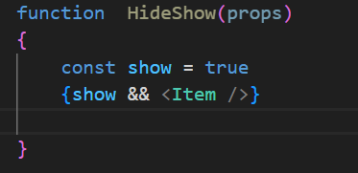
Conditional Rendering
Ternary Operator
Logical Operator

Slide 32
Hooks
React Hooks are simple JavaScript functions that allow function components to have access to state and other React features
All hooks start with use (even the ones we create ourselves).
The hook must be invoked in the function/component body.
Cannot be called conditionally .
There are some important in-built hooks but we can also create our own hooks to perform unique functions

Slide 33
useState
What is state?
The state is a built-in React object that is used to contain data or information about the component. Any change in the property values of the state object leads to the re-rendering of the component. A state is owned by its component and is locally scoped

Slide 34
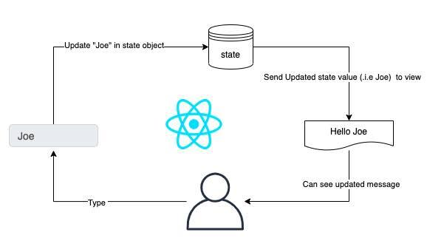
form
import React, { useState } from 'react';
setState() method to change the value

Slide 35
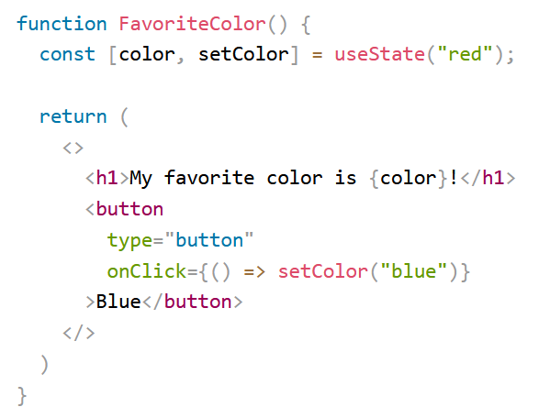
Default value

Slide 36
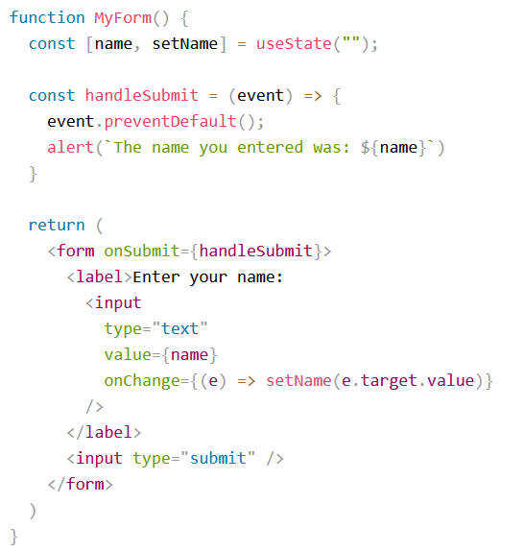
React Forms

Slide 37
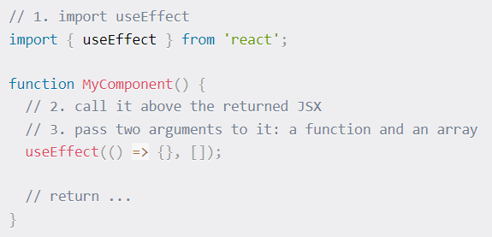
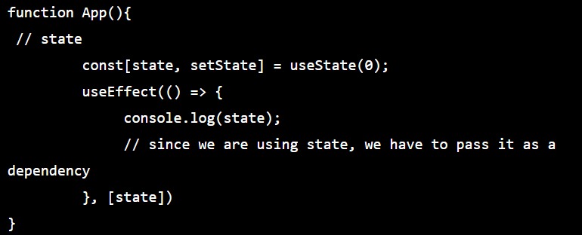
useEffect
Pure functions (like any React Component) take props and produce predictable results.
Side effects, on the other hand, involve interactions with the external world, like API requests or modifying the DOM - unpredictable.
useEffect hook provides a structured way to manage side effects, ensuring they don't disrupt component rendering and performance.
How to use:

Slide 38
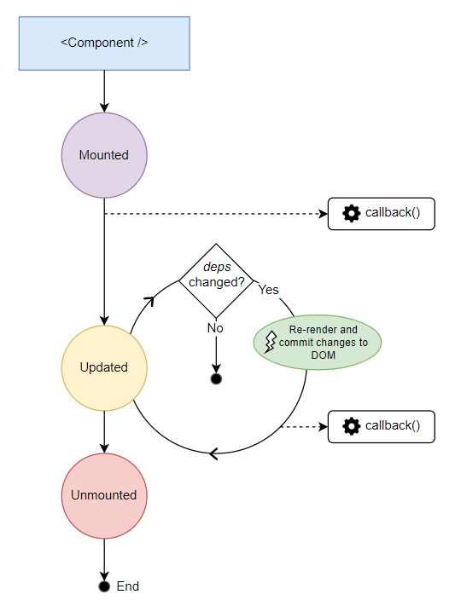
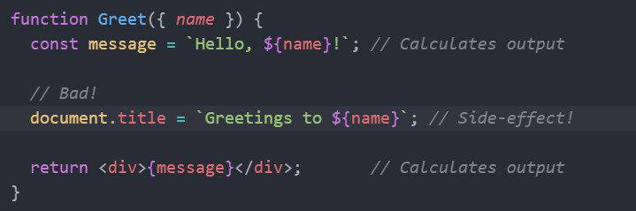
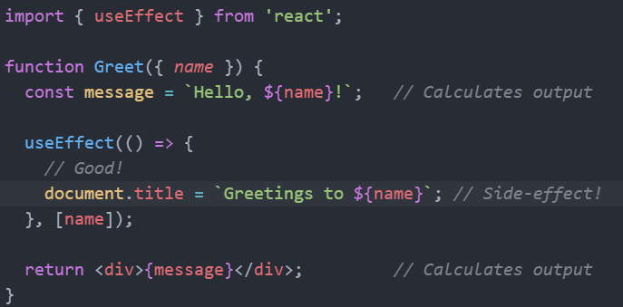
https://dmitripavlutin.com/react-useeffect-explanation/

Slide 39
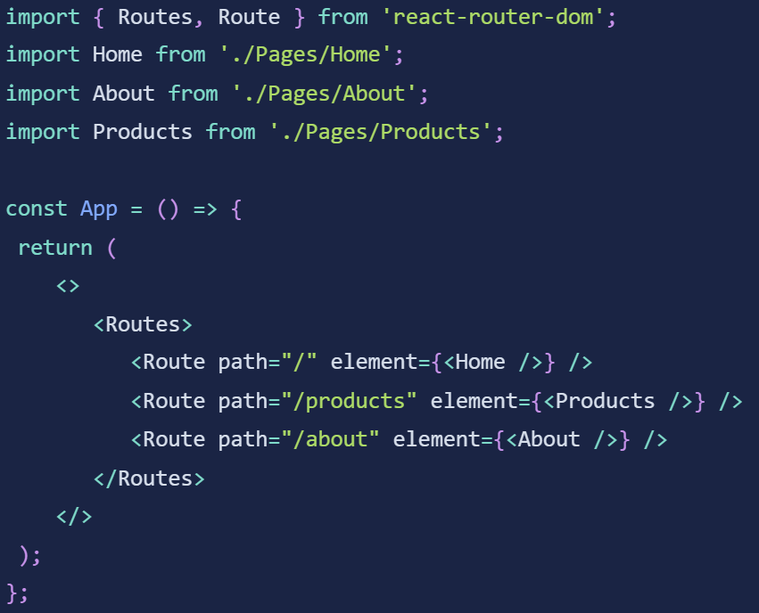
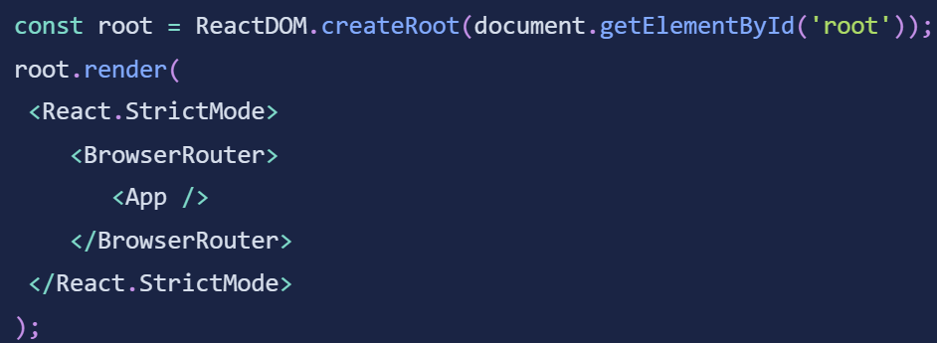
React Router
React Router is a standard library for routing in React. It enables the navigation among views of various components in a React Application, allows changing the browser URL, and keeps the UI in sync with the URL.

